Slide 1


How Long To Beat
DATABASE 2 - GROUP PROJECT
BORWOEI HUANG, MATTEO LANDO, DANIEL LUPU, ENRICO SGARBOSSA
Master’s Degree in Computer Engineering Academic Year 2022/2023

Slide 2
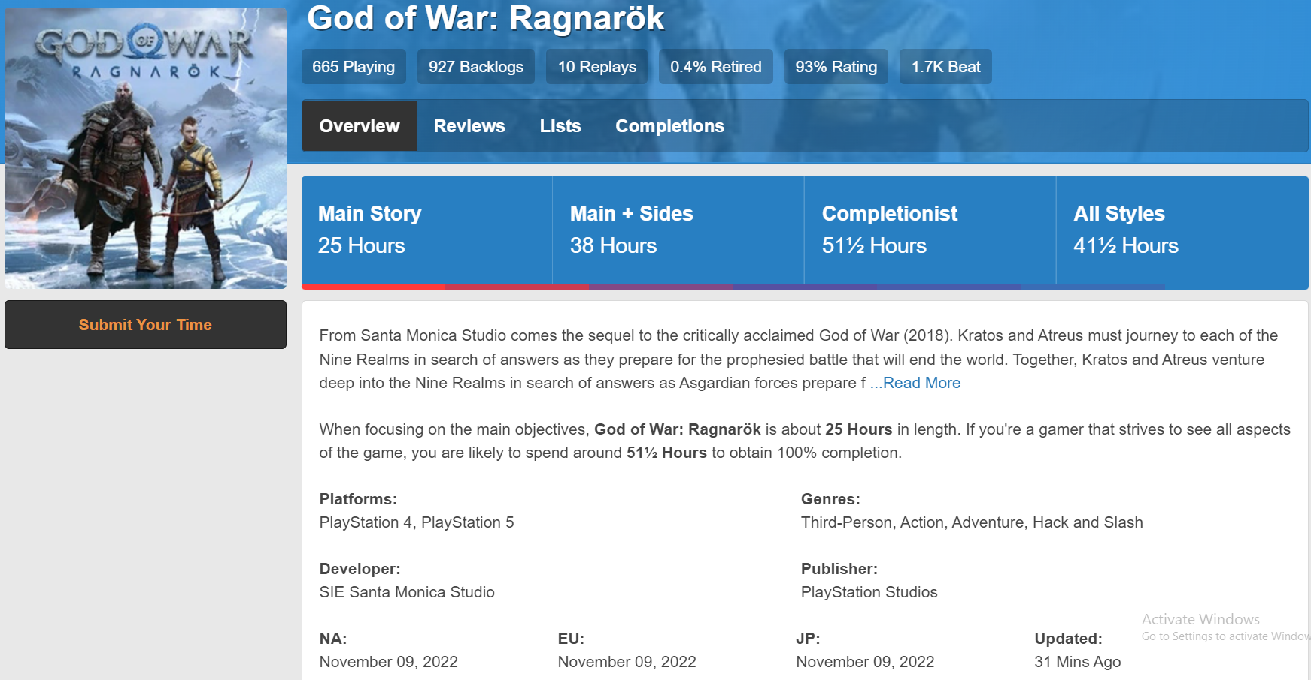
What is “How Long To Beat”
Users insert their completion status (main story, main story plus, 100%) and the completion time

Slide 3

Main Dataset
games.csv → videogames data from www.howlongtobeat.com. Retrieved from https://www.kaggle.com/datasets/kasumil5x/howlongtobeat-games-completion-times
completion_time.csv → We used Scrapy, a Python library to crawl www.howlongtobeat.com and extract completion time.

Slide 4
Other Datasets
indie-game-developers.csv and video-games-developers.csv → developer names with the headquarters, country and notable games. Retrieved from https://www.kaggle.com/datasets/andreshg/videogamescompaniesregions
vgchartz-7_7_2020.csv → sales data for videogames present on the vgchartz website. Retrieved from https://www.kaggle.com/datasets/baynebrannen/video-game-sales-2020
platforms/console_sales_vgchartz.csv → sales data for console platforms. Retreived from the web page https://www.vgchartz.com/charts/platform_totals/Hardware.php/
platforms/platforms_hltb.txt and platforms/popular_platforms_hltb.txt → list of console platforms available at https://howlongtobeat.com/stats
platforms/platforms_wikipedia.csv → table with console platforms information. Retrieved from
https://en.wikipedia.org/wiki/Home_video_game_console#Released_systems
countries-regions.csv → list of all countries containing their relevant information like codes and region. Retrieved from https://github.com/lukes/ISO-3166-Countries-with-Regional-Codes/blob/master/all/all.csv

Slide 5
Mixed Merging Approach
Games and their completion time have the same source website (www.howlongtobeat.com) → Exact match
based on the IDs taken from the website.
Games, Platforms and Companies are entities that have a registered official name in the world → Exact match (mostly)
based on the name of these entities.
Notes:
Duplicates happened in companies. It was just impossibile to match all of them with regex
first on the ids, second on the string title of the game and on the string officialName for the companies
Platforms matched with wikipedia to get the name, and we add the acryonism, match on the name
On vgcharzt, platforms are represent with it acronysm

Slide 6
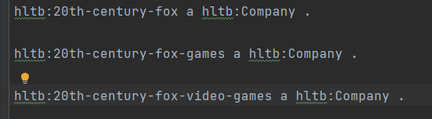
Entity Matching
Low quality data bring us to do have duplicates and manual matches.
Same resource with alternative names from different datasets → Duplicates
Not all the datasets represent the same country with the same name → Manual match

Slide 7
Our Pipeline
1
Load CSV files
Process initial datasets: remove unused columns and merge some of them
2
3
Import dataset CSVs into panda dataframes
ID creation for each node: Removing blank space and special characters.
Example: “Kiro'o Games” -> “kiro-o-games”
4
Add all data and object properties (sometimes runtime dataframes merge still needed)
5
Serialize to turtle files, one for each class
6
Add all data and object properties (sometimes runtime dataframes merge still needed)

Slide 8
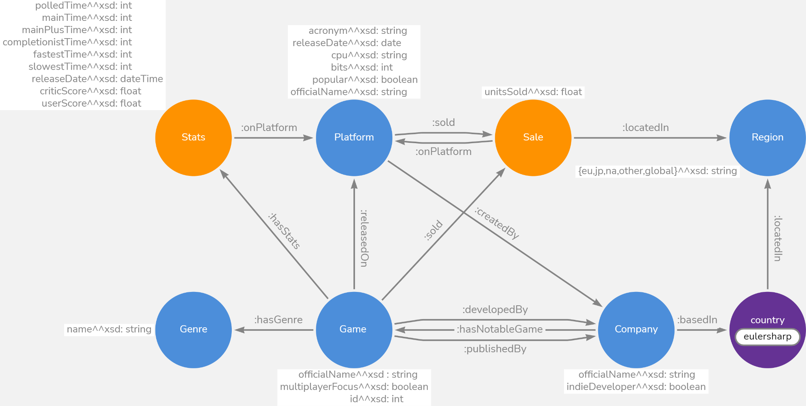
Model
Notes:
This is the model of the ontology that we create to represent all the main information about the games, like the stats of completion, the company and sale informations.
The blue nodes are the main entity, and the orange ones are the relationship about stats and Sale,

Slide 9
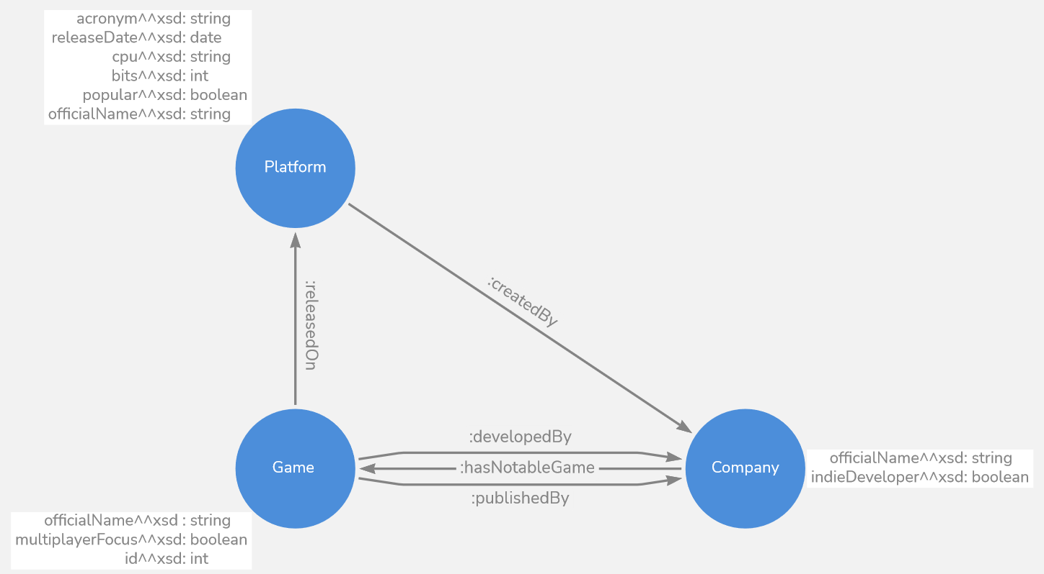
Focus I
Company represents both developers and platform manufacturers
Using readable URI to identify resources and not numbers.
e.g. hltb:the-last-of-us
Notes:
This section represent the relationship between game, company and the Platform.
The company nodes represent the company that develops games or can be the platform manufacturers.
A game can be developed by a company and published by another . Companies can have a list of notable games.

Slide 10
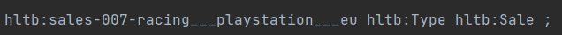
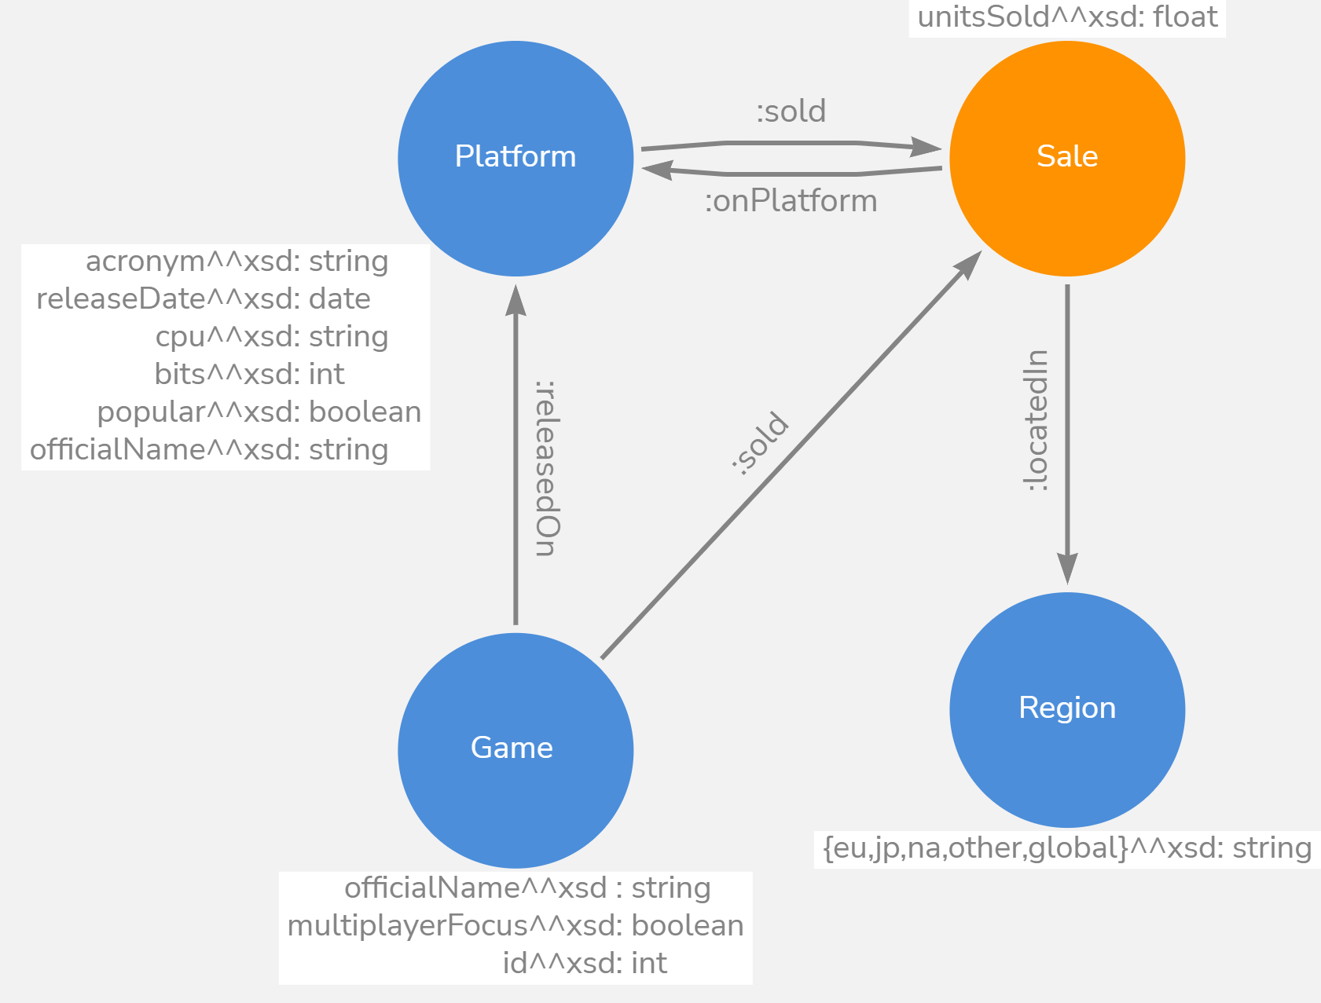
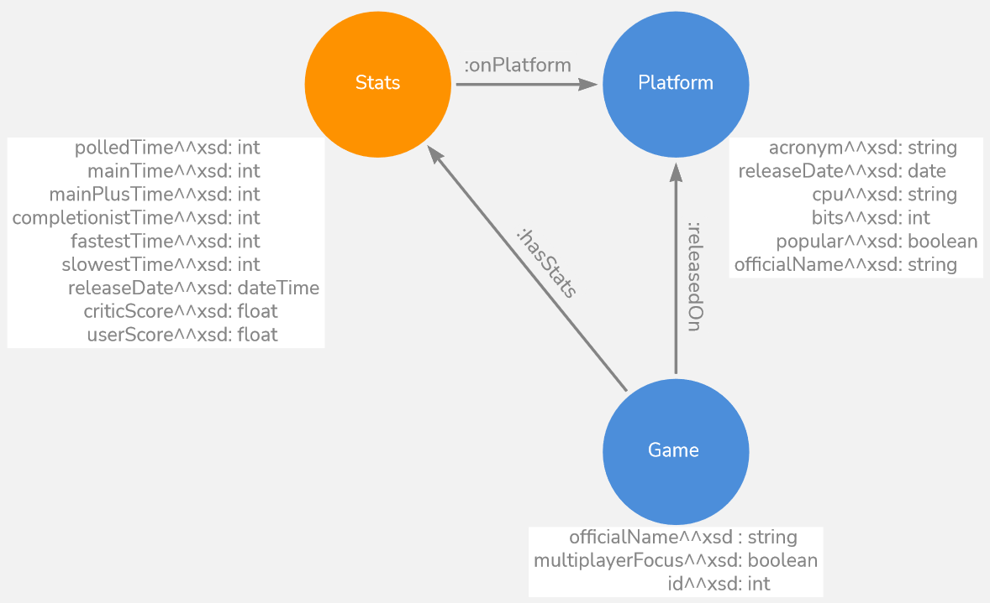
Focus II
Example of id Sale:
unitsSold exactly 1 xsd:float,
so cannot be blank
Dummy node to represent statistics about a game on a given platform
Dummy node to represent sold units for a given game, on a given platform, in a defined region
Notes:
The stats node is a dummy node were we add all stats that we scraped from the website about a game for a relative platform.
Another important node is that Sale, that is used for contain information about how many game has sold, on a give platform, on a given region. The only data property of the node is the unitSold and can't be blank.
We can see on this image an id example of Sale, where we linking information about name of game , name of platform and region.

Slide 11
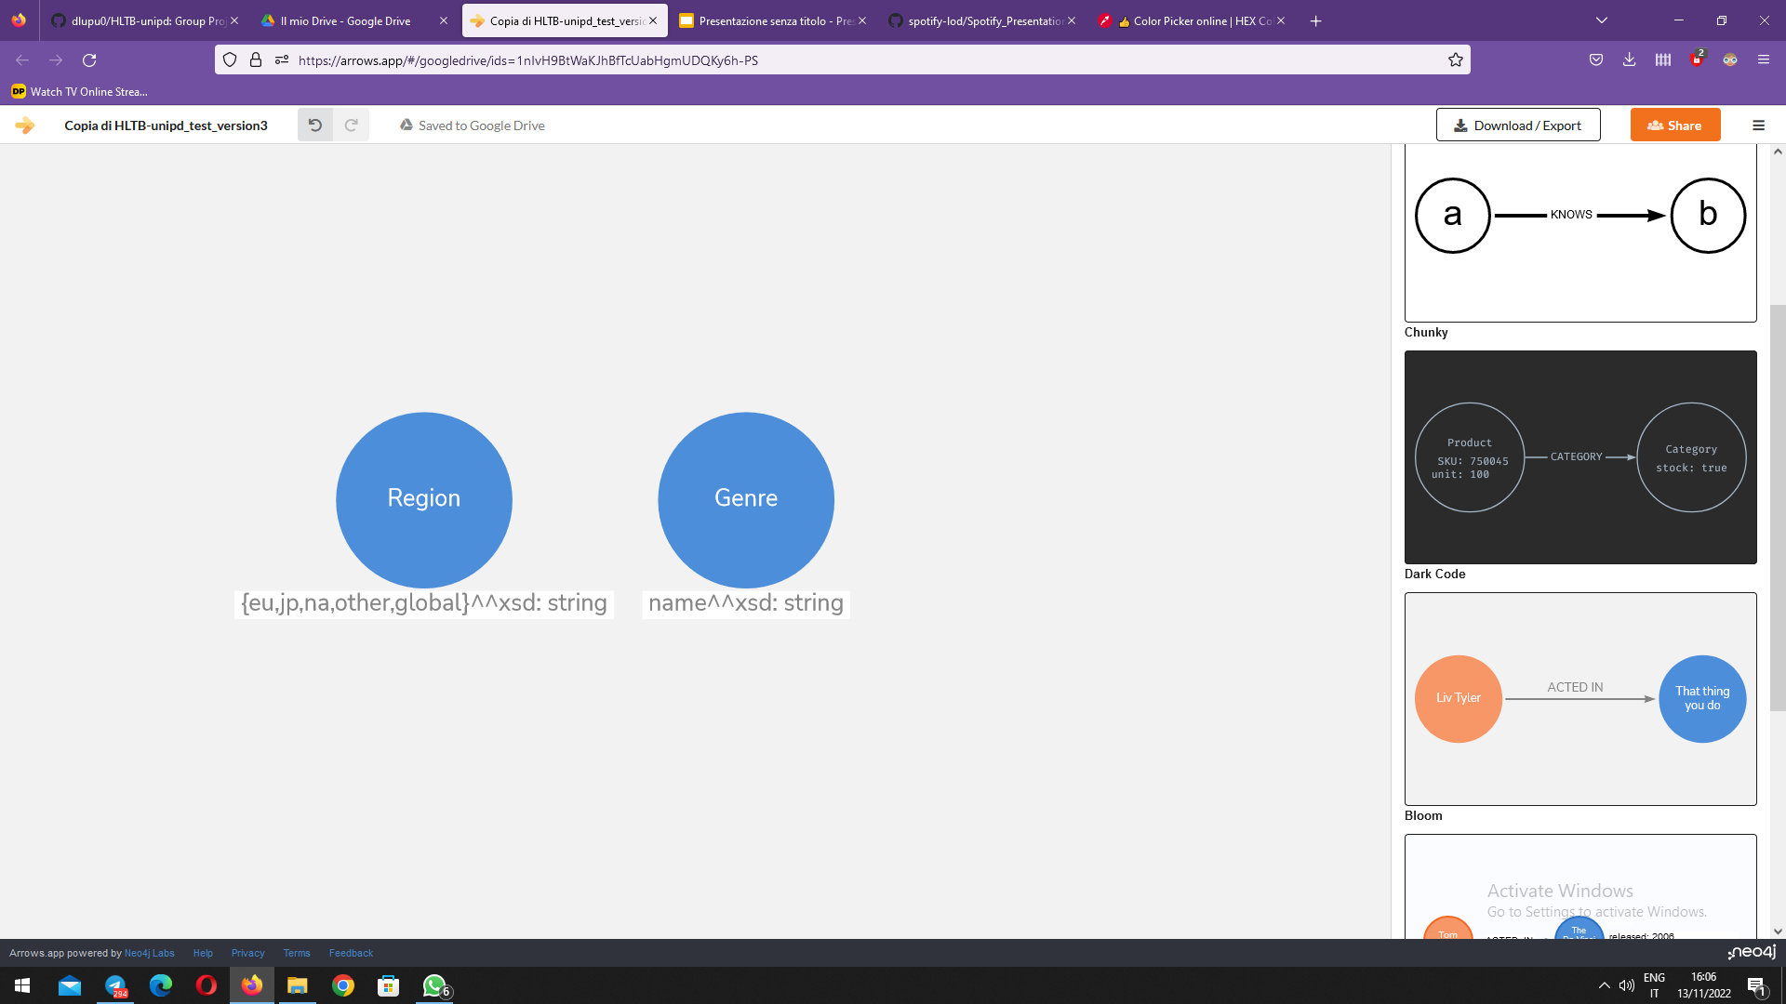
Focus III
"Beat 'em Up", "Beat 'em up" and "beat 'em up" identified by URI :beat--em-up.
NOT AN ENUMERATION
:Region rdf:type owl:Class ; owl:equivalentClass [ rdf:type owl:Class ; owl:oneOf ( countries:jp :na :eu :global :other )]
countries:jp rdf:type owl:NamedIndividual,
:Region.
ENUMERATION
Notes:
The node Genre have the name string for identify the genre of games.
We not use an enumeration because from the example we see the same Genre is written in different way and for this reason we decide to generate the id as reported.
The Region is an enumeration containing the acronym of region.
The region is used for Sale information.
(In the ttl file we add a namespace to region for identity the same "jp" acronym used for the region and for the country Es. counties htlp:jp )
In the example we have the individual jp is a type Region but also a Country
For model the countries we use the SKOS Datasets.

Slide 12
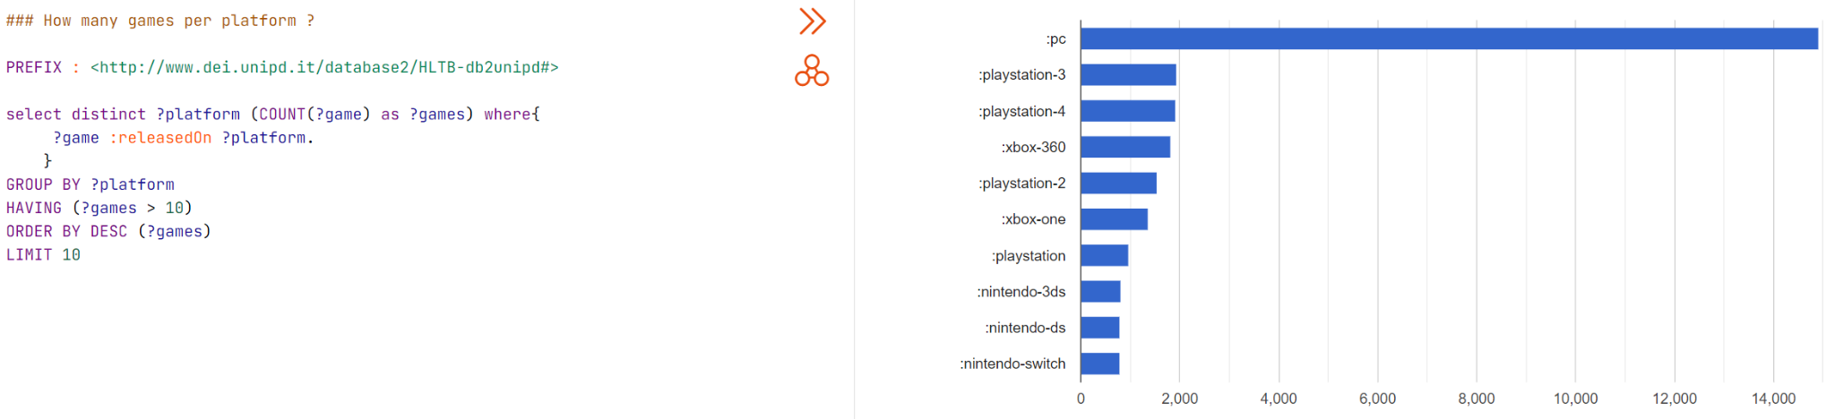
Query 1 - How many games per platform?
Notes:
30 seconds per query. Skip some queries if not enough time
The first query is simply a relation of “game released on platform”. GROUP BY platform and count the number of games on each platform.

Slide 13
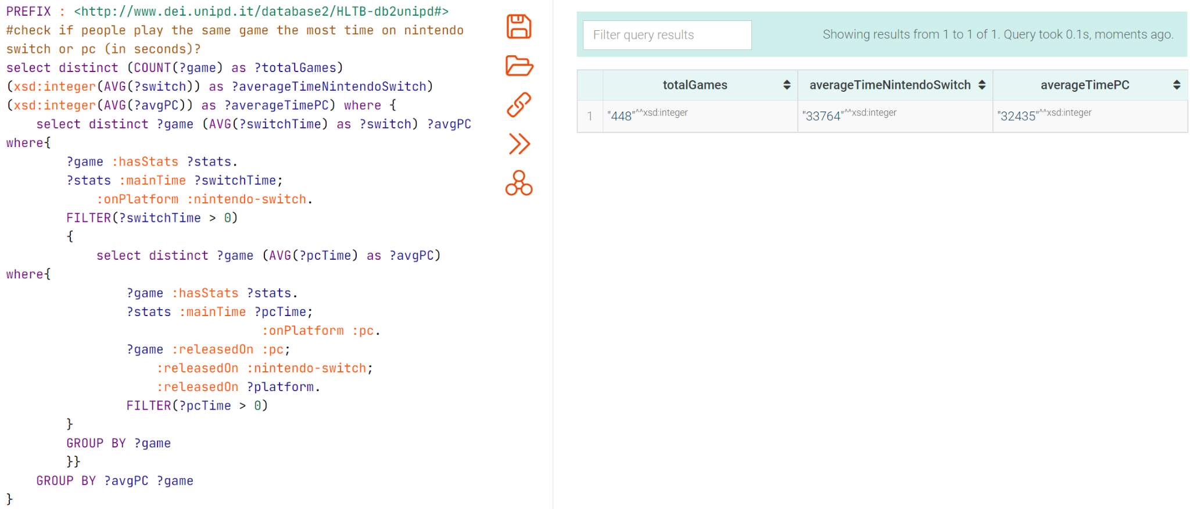
Query 2 - Do people play the same game the most time on Nintendo Switch or on PC?
Notes:
There two subqueries. One to compute the average time on switch, the other to compute the average time on PC.

Slide 14
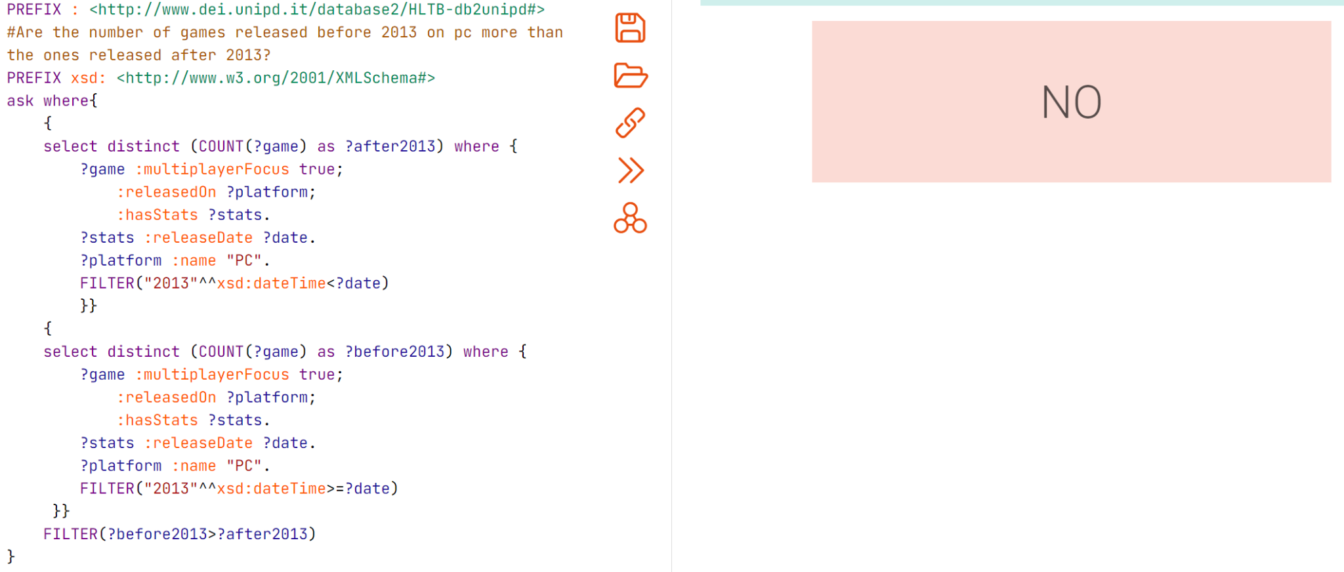
Query 3 - Are the number of games released before 2013 on PC more than the ones released after 2013?
Notes:
We use “ask where” to compare the number of games released before and after 2013. One subquery filter the release date before 2013, and the other subquery filter the release date after 2013.
The answer is “no” as there are more games released after 2013.

Slide 15
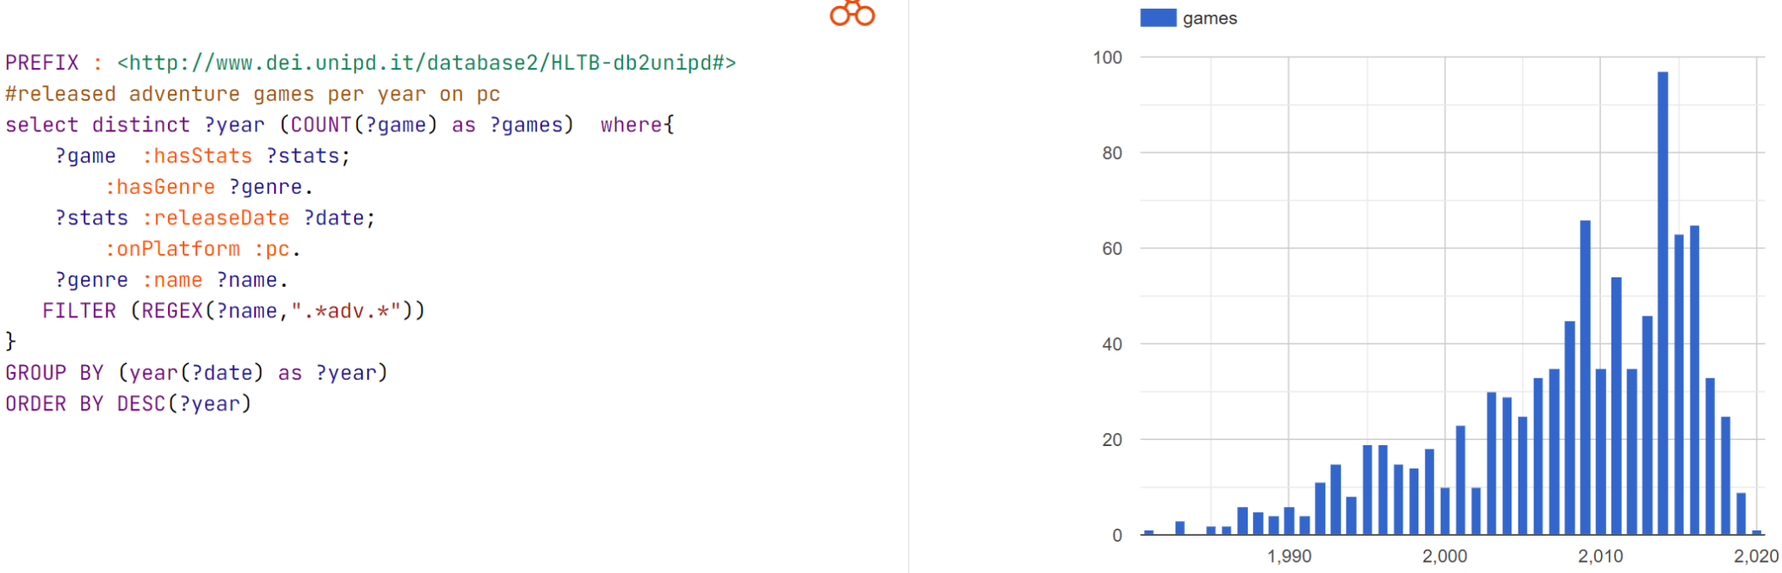
Query 4 - How many adventure games are released on pc?
Notes:
We collect the genre of of the games with the key substring “adv” . The histogram shows the number of adventure games every year.

Slide 16
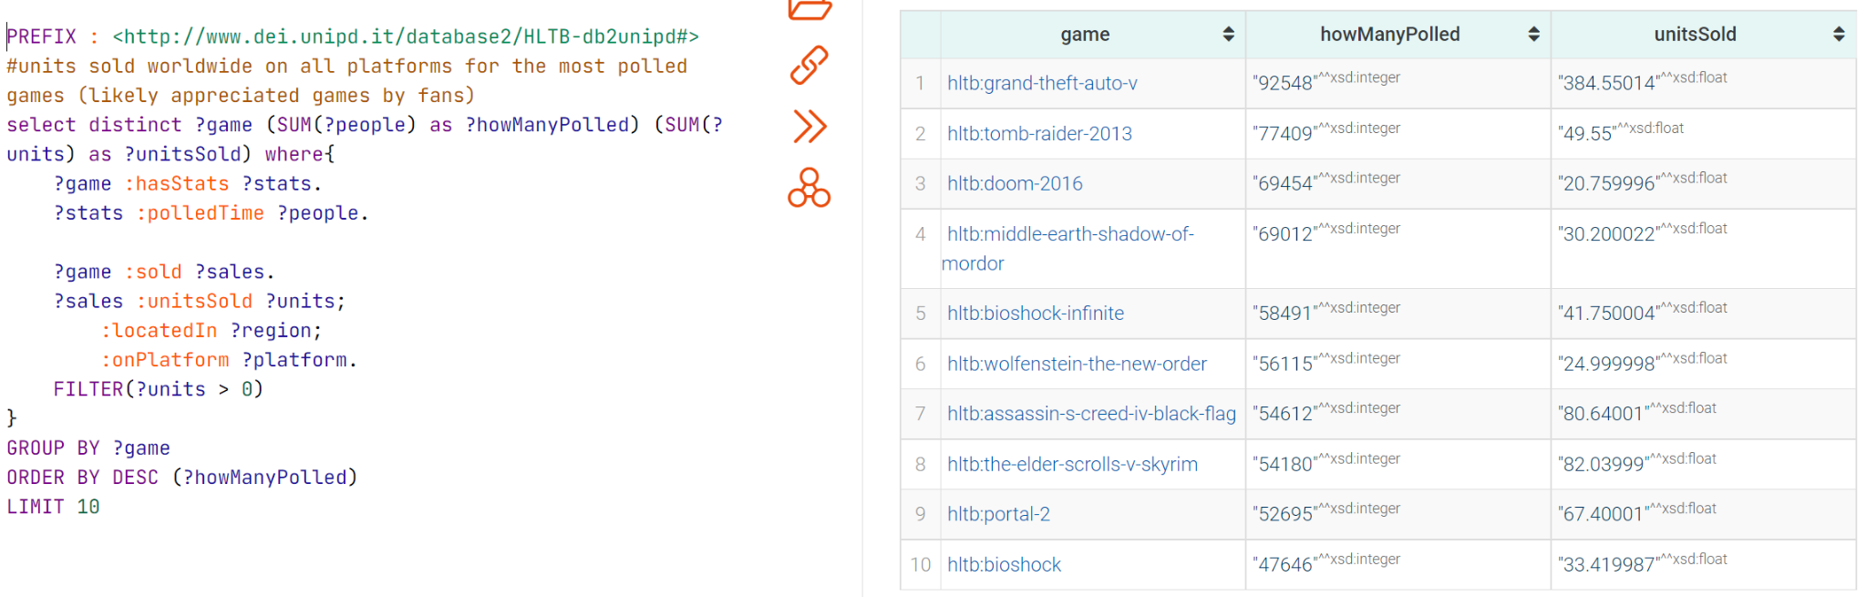
Query 5 - How many copies sold the most appreciated games ?
Notes:
The most appreciated games are those with high numbers of polls. Therefore, we take the summation of polls of the games. and compute the total number of unit sold of those most appreciated games.

Slide 17
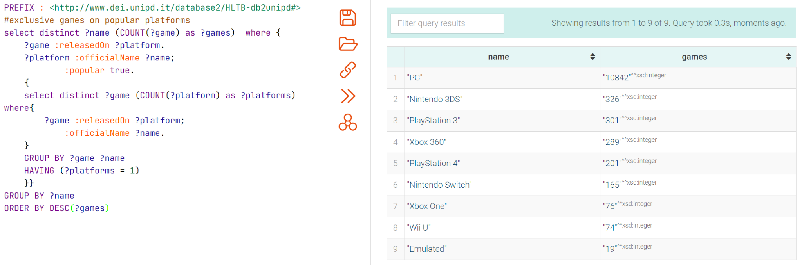
Query 6 - How many exclusive games each popular platform has?
Notes:
In this query, we only look at popular platforms, so we take the platform with popularity attribute “TRUE”. and count the number of games released on those popular platforms.

Slide 18
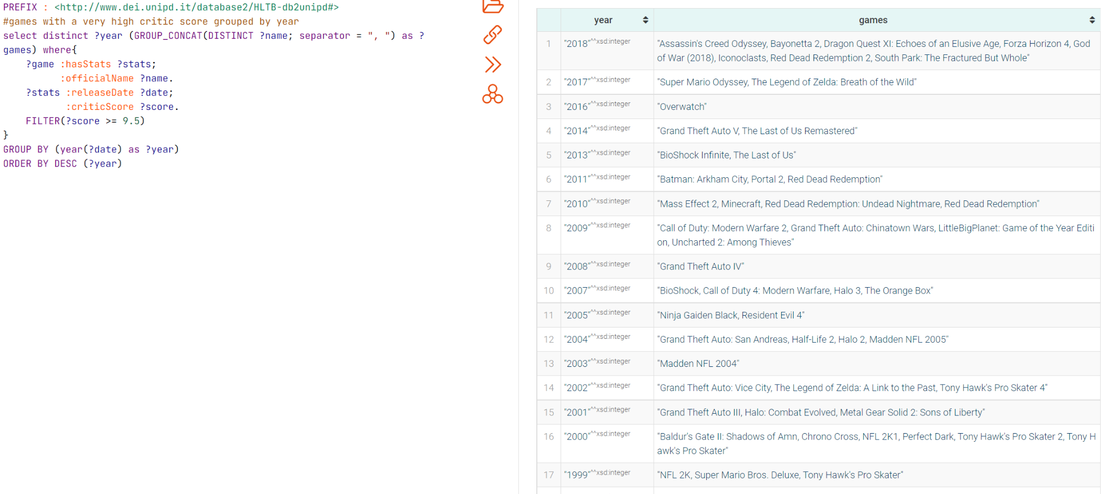
Query 7 - What are the most praised games by the critic?
Notes:
The most praised games are those with scores higher or equal to 9.5. So we filter the score>=9,5. And then collect the game names in each year.

Slide 19
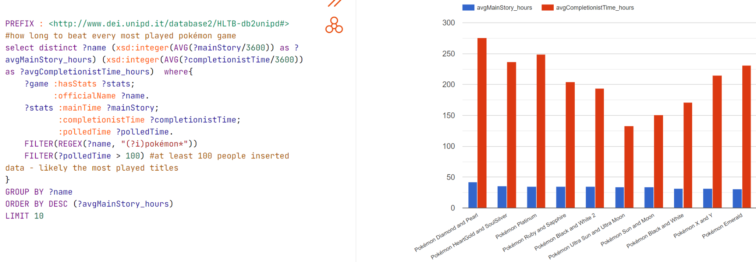
Query 8 - How long does it take to beat the most played Pokémon games?
Notes:
Here we focus only of Pokemon games, so we take the game names contain “Pokemon”. Then, we compute the average time to beat the main story and the average time to complete the games. The figure shows the time to beat the games in the unit of hour.

Slide 20
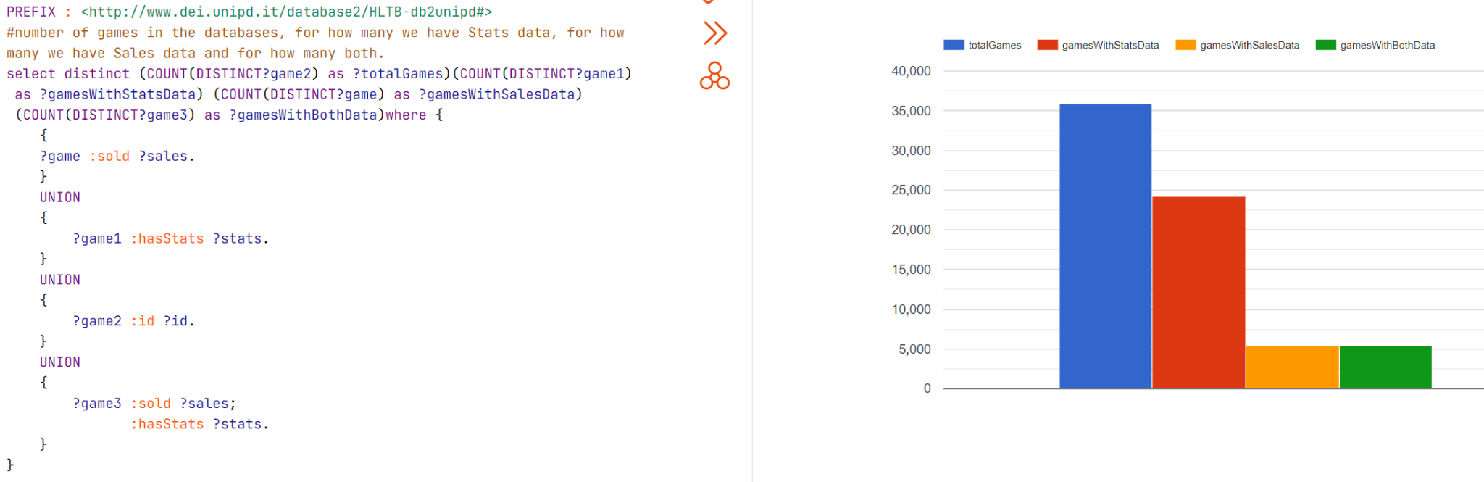
Profiling Query 1 - Total games and correlated data

Slide 21
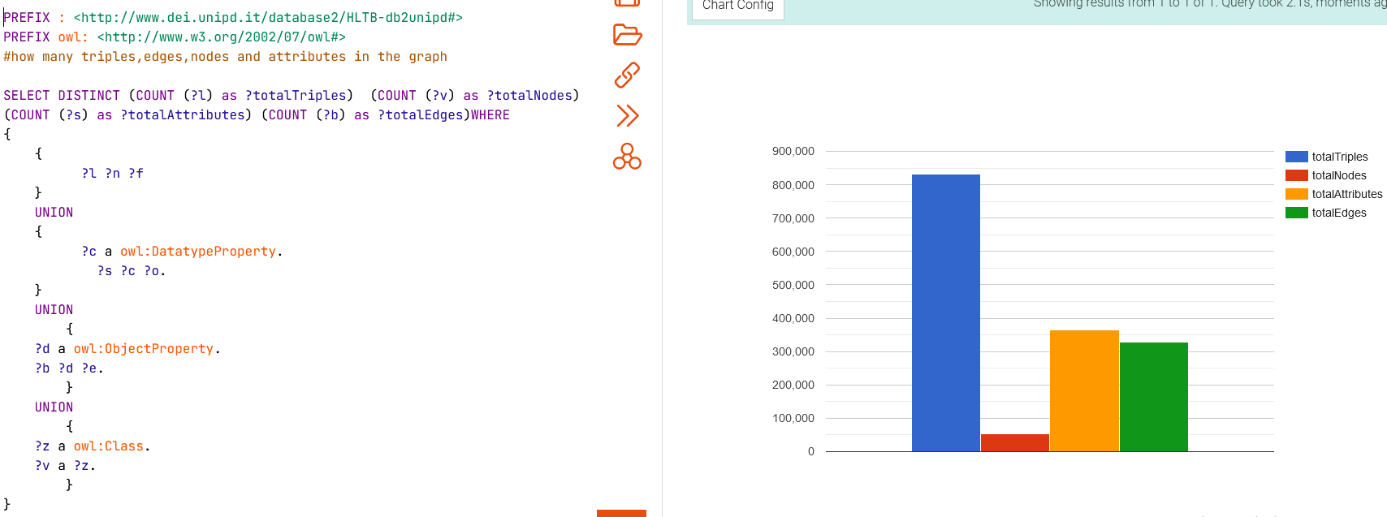
Profiling Query 2 - RDF Triples, Nodes, Attributes and Edges

Slide 22
Thank you for the attention!
謝謝參與
お清聴ありがとうございます
BORWOEI HUANG, MATTEO LANDO, DANIEL LUPU, ENRICO SGARBOSSA

